Slide 1
Cyber Threat Principles

Slide 2
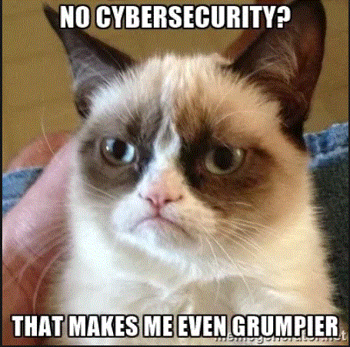
Exactly what are the cyber threats?
Malware – Virus, Worm, Trojan, Rootkit, Spyware and Ransomware
Network Sniffers
Social Engineering
Session hijacking
Botnets
Stealth scanning and keyloggers
Distributed denial of service attacks
Phishing
Spoofing
Password cracker

Slide 3
Malware
Virus – A software program that attaches or copies itself into another program
Worms – Self contained malware that replicates and sends copies of itself to other computers, usually on a network
Trojans – Malware that hides as a useful or harmless program
Rootkits – Rootkits replace or modify an existing program to hide the fact the computer has been infected
Spyware – Software that covertly collects information without the user’s knowledge or permission
Ransomware – Malware that attempts to generate funds directly from a computer user

Slide 4
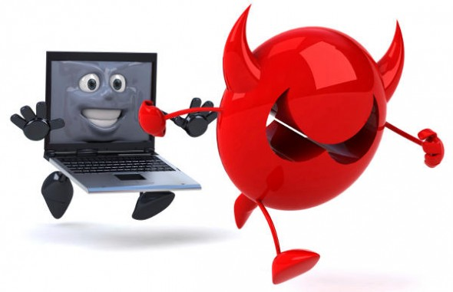
Network Sniffers
A packet sniffer is a program that can see all of the information passing over the network it is connected to. As data streams back and forth on the network, the program looks at, or "sniffs," each

Slide 5

Social Engineering
Social engineering doesn’t just deal with technology.
It is the act of persuading people to give away information that most likely will be used against them or their company.
It has become very popular in getting information to penetrate organizational network defenses.

Slide 6
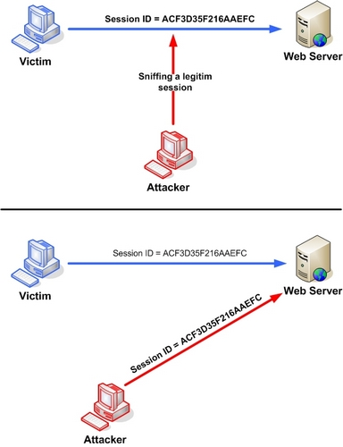
Session Hijacking
A network attack where the attacker attempts to take over the connection between two networked computers.

Slide 7
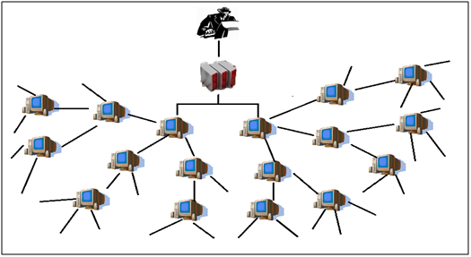
Botnets
A robotically controlled network of compromised computers that attackers use to launch attacks and spread malware.

Slide 8

Stealth Scanning and Keyloggers
Stealth scanning is a type of scanning that uses a variety of techniques to conceal itself from the user.
Keyloggers are usually hidden programs that record every keystroke and sometimes every website and message that is sent from a computer.

Slide 9
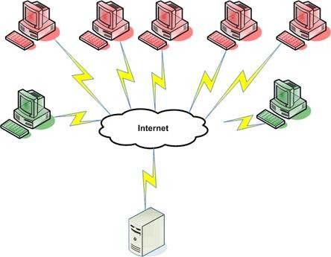
Distributed Denial of Service Attacks
An attack that uses ping or ICMP messages to bring down the availability of a server or system.
DDoS attacks initiate from more than one host device.

Slide 10
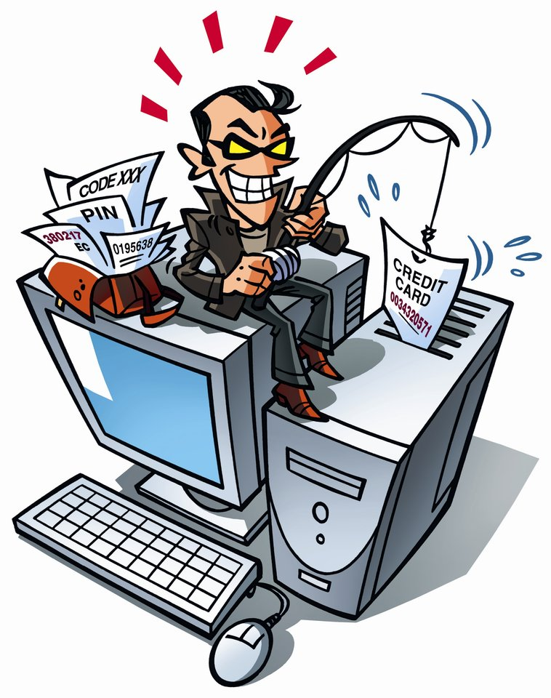
Phishing
A type of fraud where an attacker tries to trick the victim into providing private information, often using email or the phone.

Slide 11
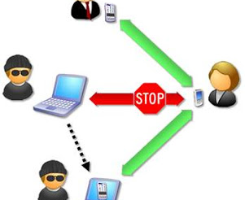
A type of attack where a person, program or computer disguises itself as someone or something else to gain access to a resource.
Spoofing

Slide 12

Password Cracker
A software program that can run a brute force attack to gain access to a system or a recovery of passwords stored in a computer system.
A hash is the unique number produced by a hash algorithm when it is applied to dataset, which will verify the integrity of the data.
A salt is random data that is used as an additional input to a one way function that hashes a password. The purpose of most salts is to defend against dictionary attacks versus a list of password hashes and against pre-computed rainbow table attacks.
Rainbow table attacks are targeted toward passwords in which every combination of characters is hashed and then compared to a hashed password later.

Slide 13
Defense By Hiding
Steganography – The practice of concealing a file, video, image, or message within another file, video, image, or message.
Cryptography – The practice of hiding information
Encryption – The act of transferring cleartext data into (supposedly) undecipherable ciphertext

Slide 14
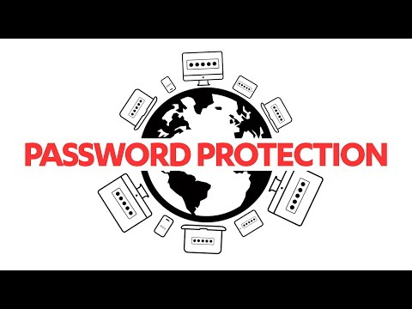
Password Cracking

Slide 15
Password Cracking Speeds
Modern GPUs are making password cracking faster and faster.
In 2012 a 25 GPU system was built to crack every 8 character Windows password...it took 5 ½ hrs to crack all possible combinations.
350 BILLION guesses per second!
In 2019, a security researcher took a data breach containing 14 million passwords and cracked 11 million of them using a AWS cloud based NVidia Tesla K90 GPU...in 20hrs...for $18.
800 MILLION guesses per second and cloud based!
Password length is the best way to protect your accounts
At least 15 characters...though more is better
Add complexity (special characters, numbers, upper and lowercase) to further decrease the chances of being cracked

Slide 16
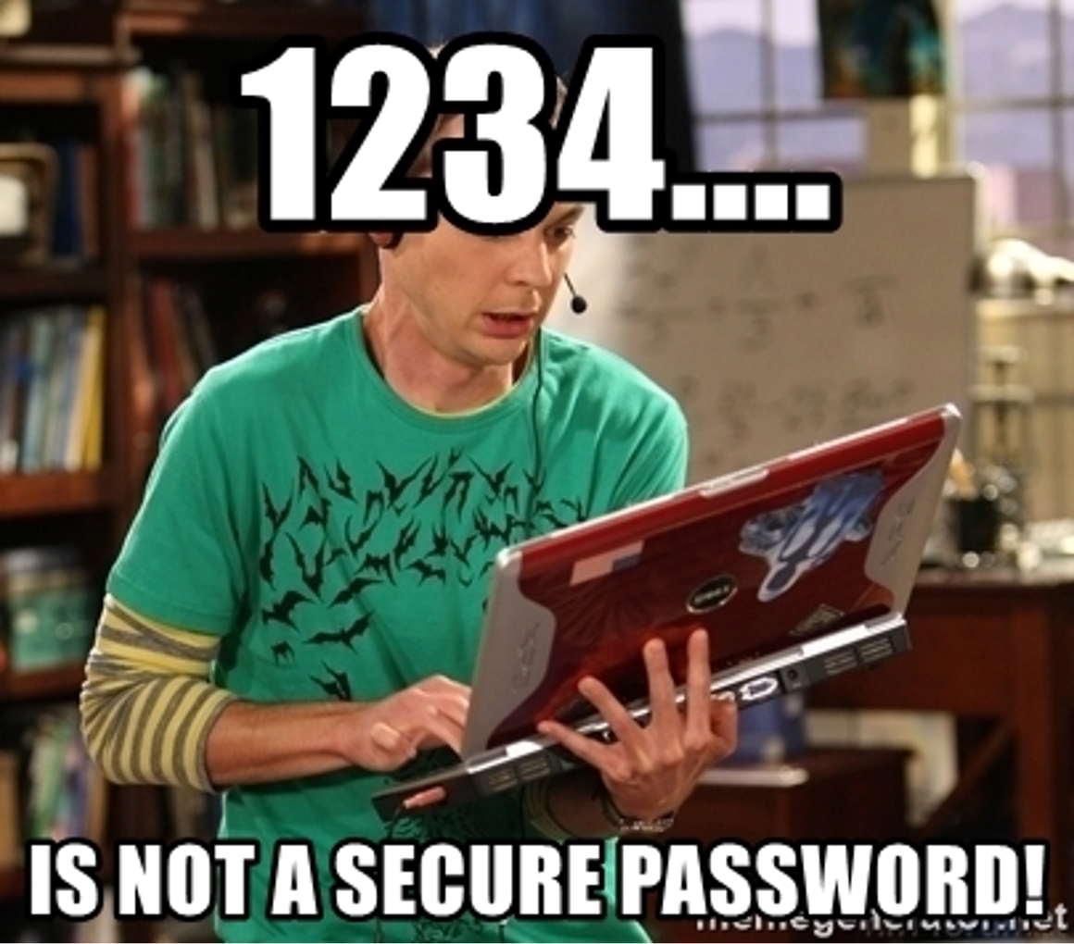
Demo of Password Lab
Hash type used?
0223b799d526b596fe4ba5628b9e65068227e68e:f6d45822728ddb2c
Create MD5 hash
GenCyber2020
Crack a hashed password
85ce57158fe94a36d6ca4028d8125378

Slide 17


Slide 18
Resources
How Stuff Works, http://computer.howstuffworks.com/workplace-surveillance2.htm
Fundamentals of Information Systems Security, David Kim and Michael Solomon, 2014.
https://hackernoon.com/20-hours-18-and-11-million-passwords-cracked-c4513f61fdb1

